Slide 1
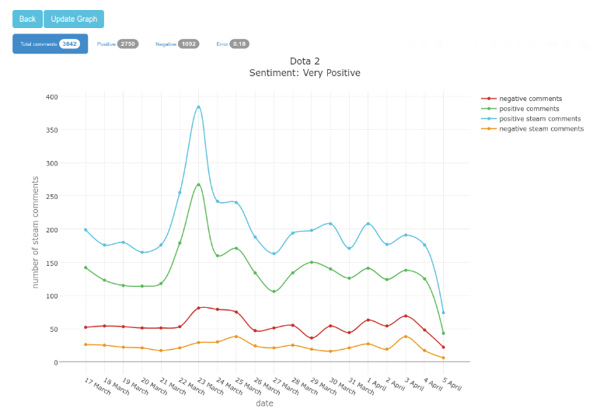
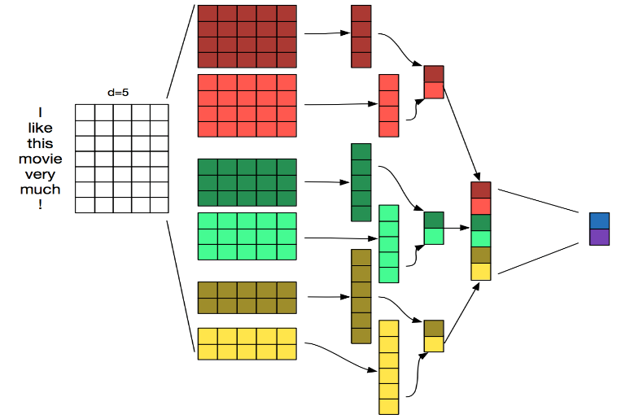
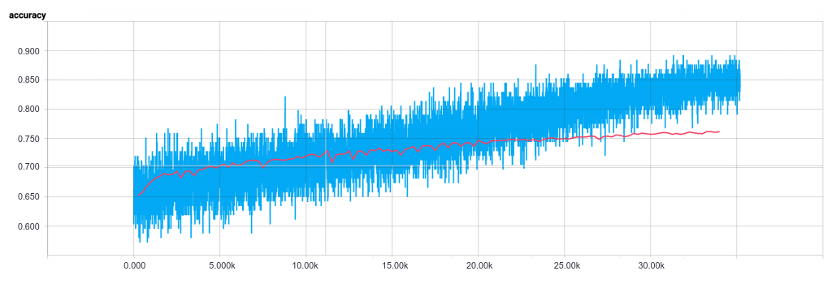
Steam Games Sentiment Analysis
Solution
The model successfully predicting the sentiment for the Steam game Dota2 with an accuracy of 84%.
REALIZED BY: MALEK DOGHMAN
ENSIT SUPERVISOR: NARJES HACHANI
IP-TECH SUPERVISOR: SEIFEDDINE DRIDI
For this classification task, we decided to use a Convolutional Neural Network.
The training dataset is extracted from Steam, Amazon, LMDb …
Introduction
Sentiment analysis is a subfield of natural language processing (NLP) and artificial intelligence.
It is used to analyze a user opinion, review or comment for further reuse.
Results
Conclusion
Problematic
The implemented model of the CNN build on top of word2vec reached an accuracy of 76% on the test data
Our solution can be further improved in several ways
-Instead of a binary classification, we can introduce a fine grained analysis.
-Product Feature extraction: The model will be able to predict the product feature that made a user satisfied with the product.
Using a naïve algorithm to classify a review into positive or negative will not give us the expected results.
1
2
3

